Slide 1
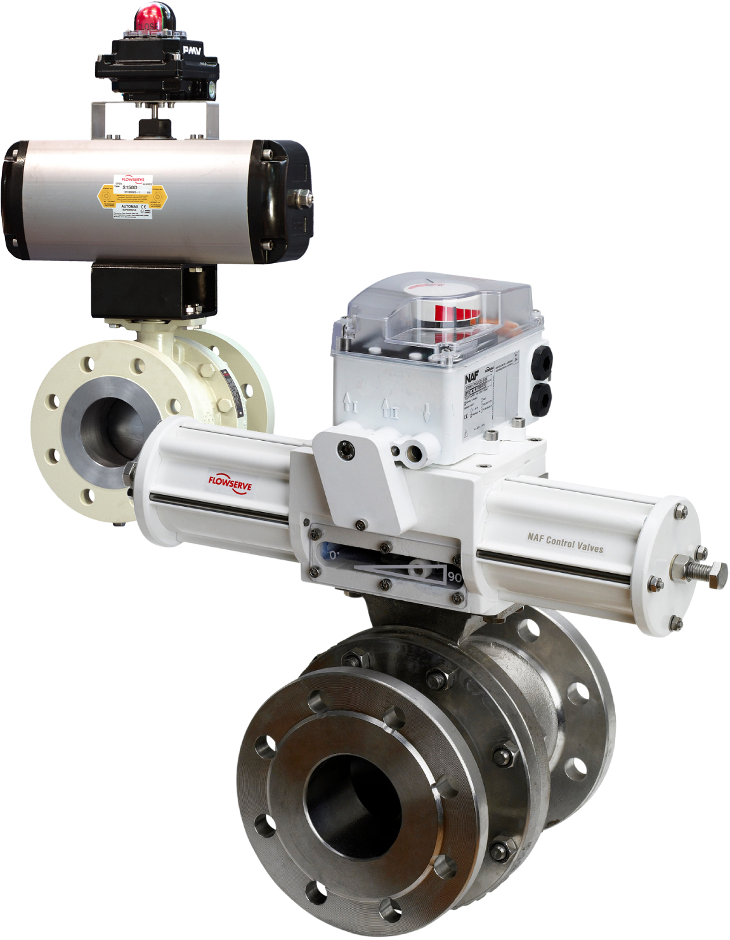
FLOWSERVE NAF
Duball DL Product Presentation

Slide 2
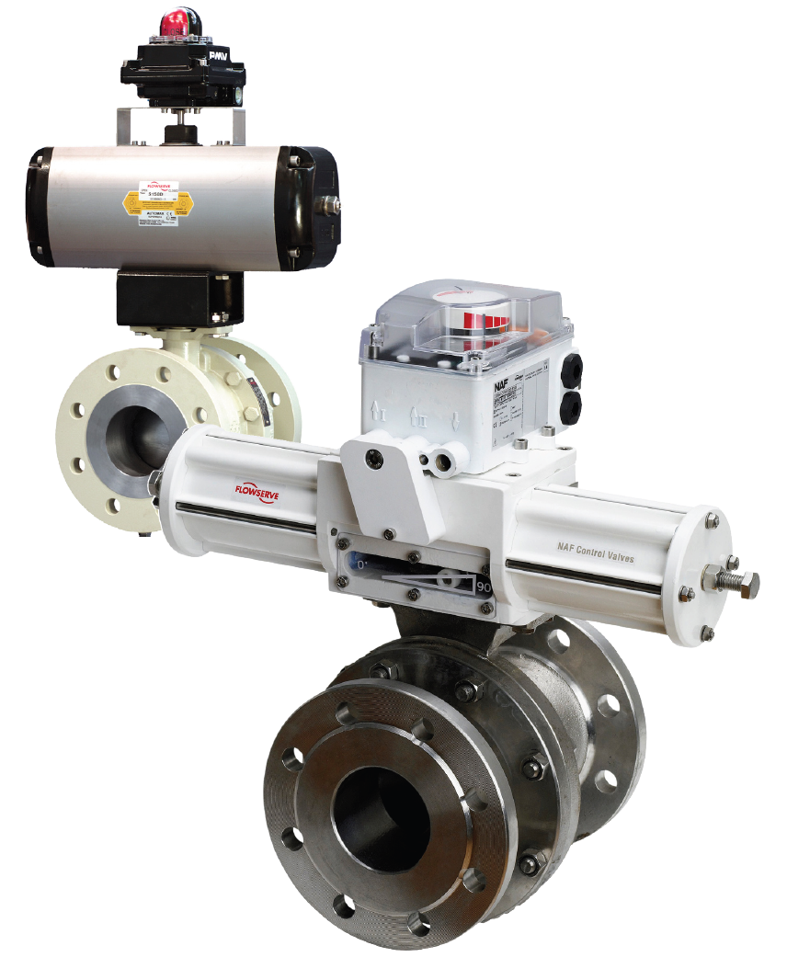
What is the NAF Duball DL?
High performance ball valve
Metal or soft seated
Full bore, two piece body
Floating ball

Slide 3
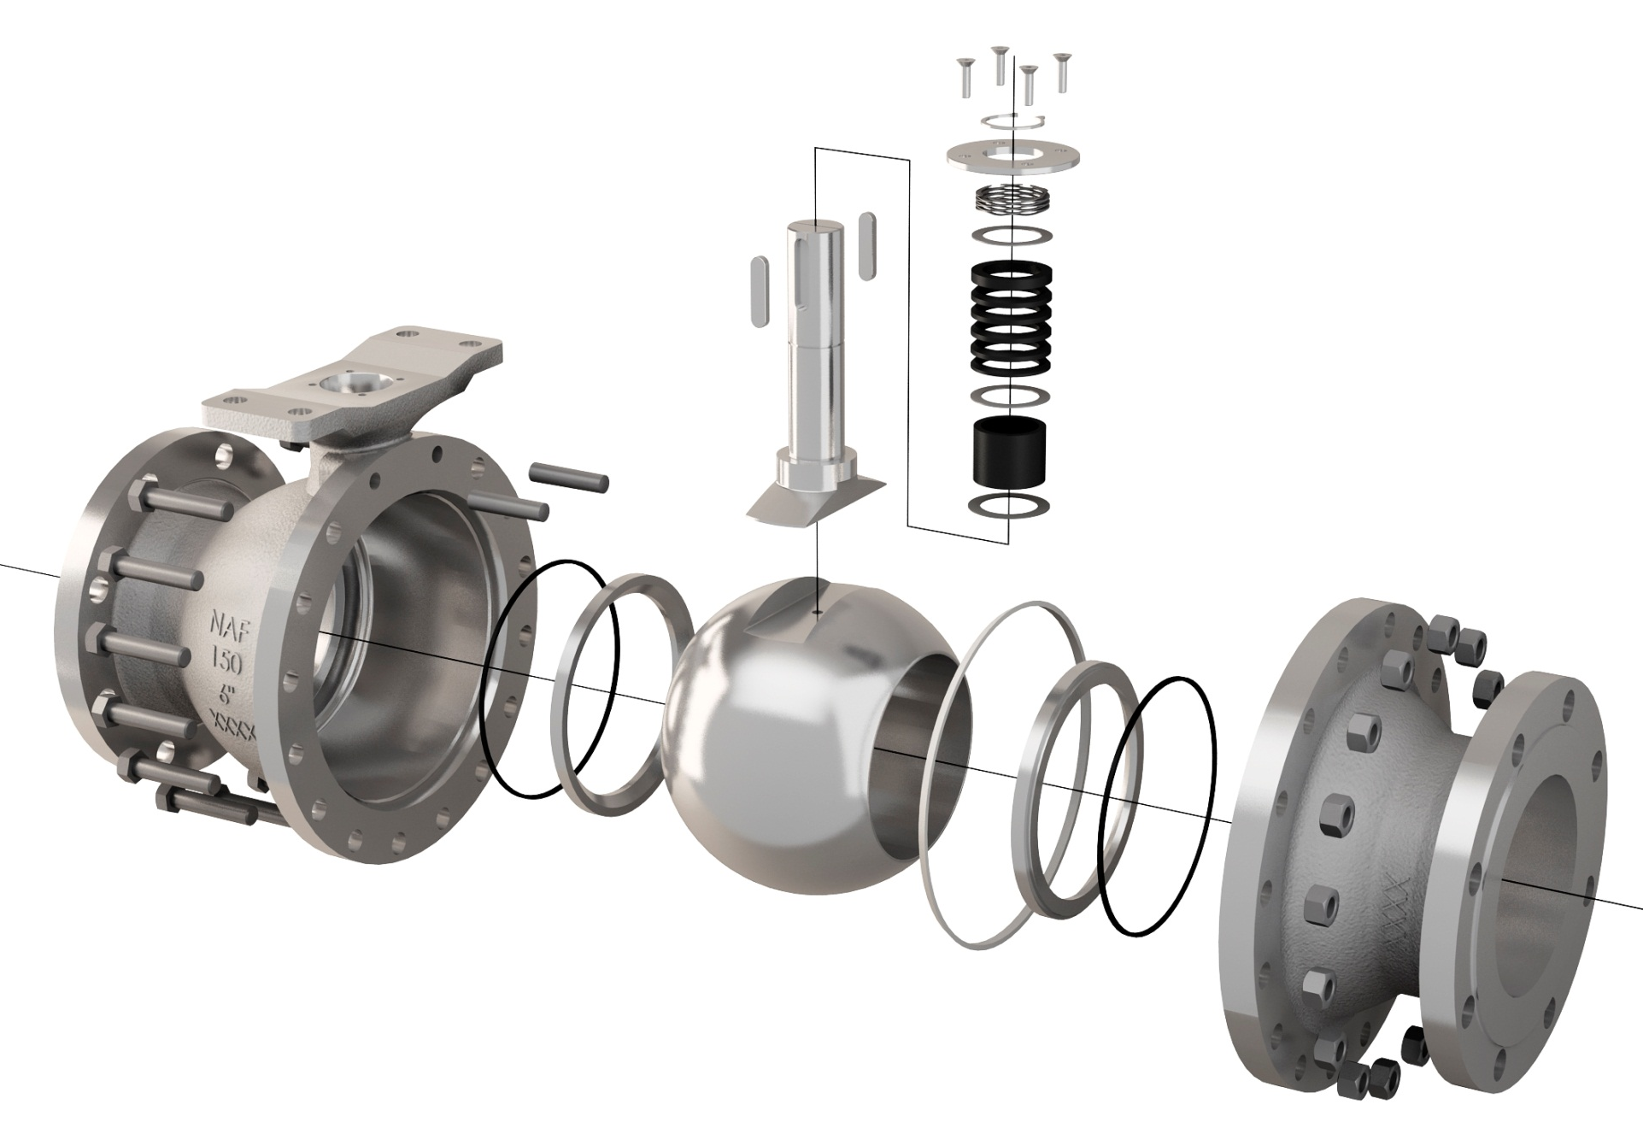
NAF Duball DL design
Direct actuator mounting of the Turnex actuator which provides a high performance, vibration resistant, compact valve package > Lower maintenance cost, better control performance
Spring loaded stem seal packing > Minimized risk for non-planned plant downtime and emissions to atmosphere
Up to 250°C/482°F in it’s standard configuration > Minimized inventory need due to the temperature coverage
Blowout-proof stem with a long foot providing a high torque transmission with a minimum mechanical backlash > Safe operation, better control performance

Slide 4
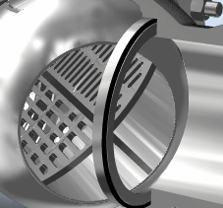
NAF Duball DL design
Unique Z-trim™ option that minimizes cavitation and noise and has an excellent control characteristic > Better working environment, lower maintenance cost for wear, better control performance

Slide 5
NAF Duball DL design
Metal seats with a rigid welded overlay of Alloy 6 or alternatively metal encapsulated, reinforced PTFE seats > Minimized risk for non-planned plant downtime due to seat damage

Slide 6
NAF Duball DL design
Blow out proof stem
Direct mounting
of Turnex
Spring loaded Stem Packing (V-rings)
Two-piece Off-centre
Metal- or soft seated
Floating Ball, standard or Z-trim

Slide 7
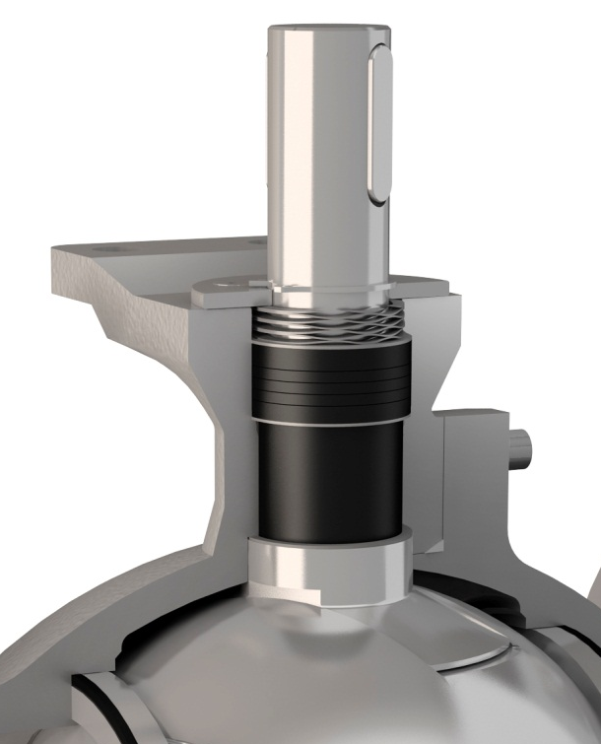
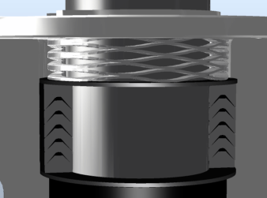
Spring loaded stem seal packing
Wave spring, preload > no need for manual re-tightening
R-PTFE V-rings >
  multistage seal,
  minimum risk for leakage
  250°C/482°F as standard
  also available in a fire safe version
High thrust, anti-friction
washer > can take high
pressure and high cycle applications

Slide 8

NAF Duball DL, standard seats
Seat area

Slide 9
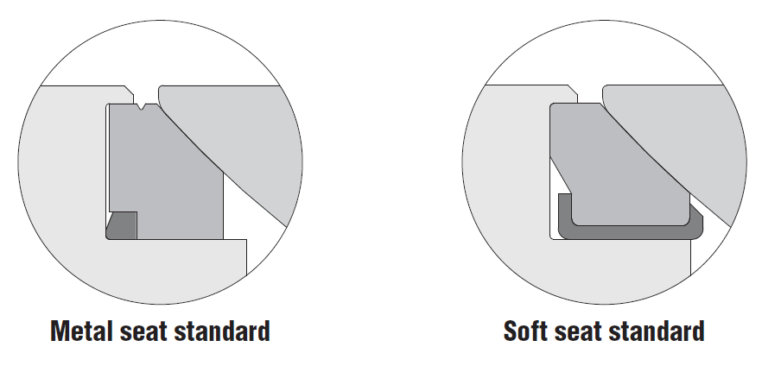
NAF Duball DL, standard seats
Both seat designs are very rugged and rigid > Minimized risk for non-planned plant downtime due to seat damage
Extraction groove >Makes it easier to remove seat even when it has been used for the most difficult media
Lip (part of the body) > Protects the seat and prevents the soft seat from plastic deformation under load
Lip (part of the body) > Protects the seat from erosion
Ball
Ball
Body
Body
Seat
Seat
Metal seats with a rigid welded overlay of Alloy 6 (min 2 mm)
Metal encapsulation > Prevents the soft seat from plastic deformation under load

Slide 10
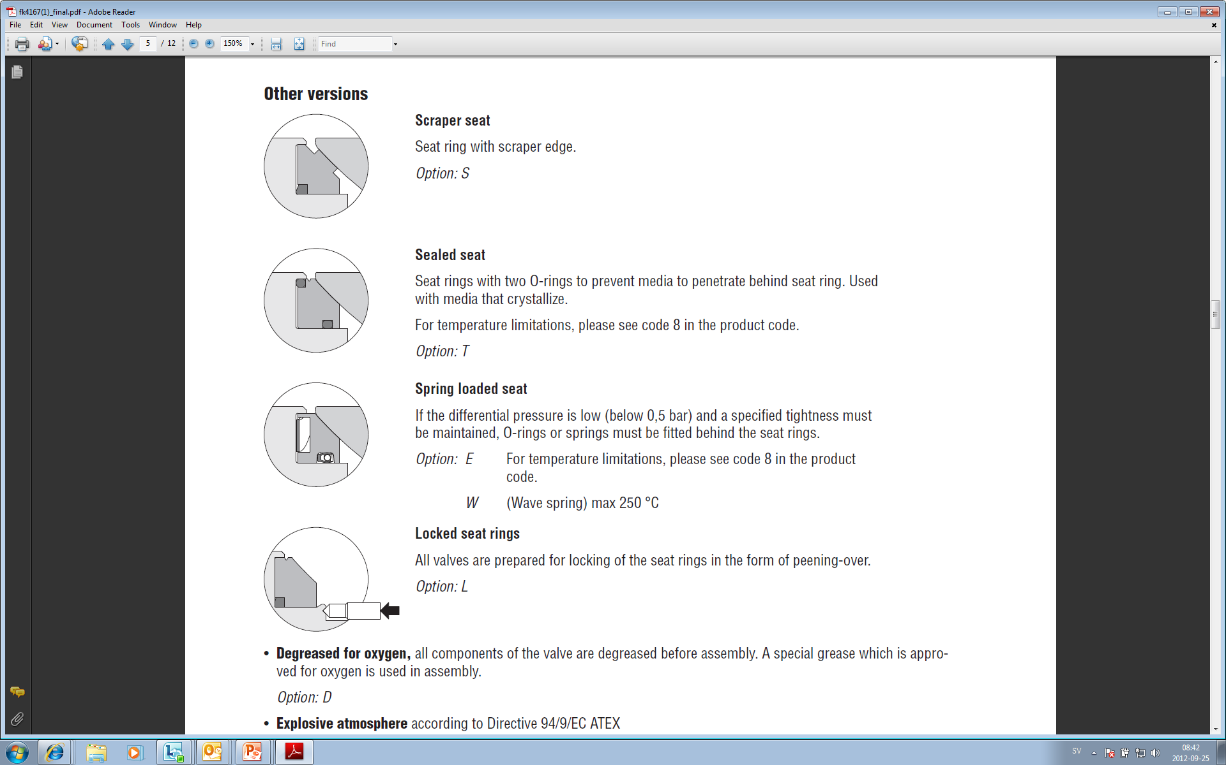
Metal seat, optional configurations
Scraper seat- To be used when media has a tendency to stick to the surface of ball and seat
Sealed seat- Prevents media from build-up behind the seat. Unique solution for crystallizing media.
Spring loaded seat- O-ring or wave spring loaded seat to maintain a high tightness at differential pressures below 0,5 bar.
Locked seat rings- Seat locking is prepared on all valves. Locked seats reduced torque increase as a result of media build-up behind seats and on steam applications.

Slide 11
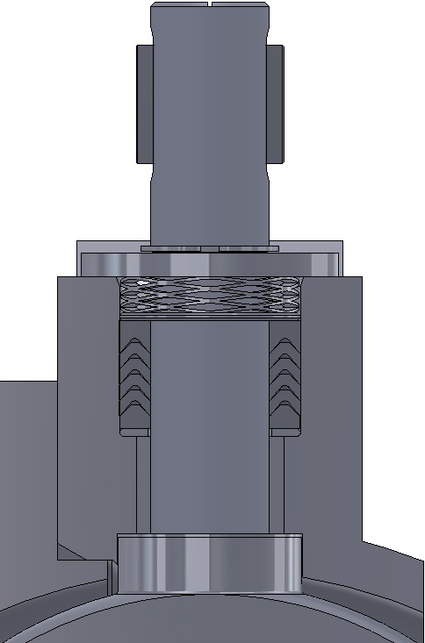
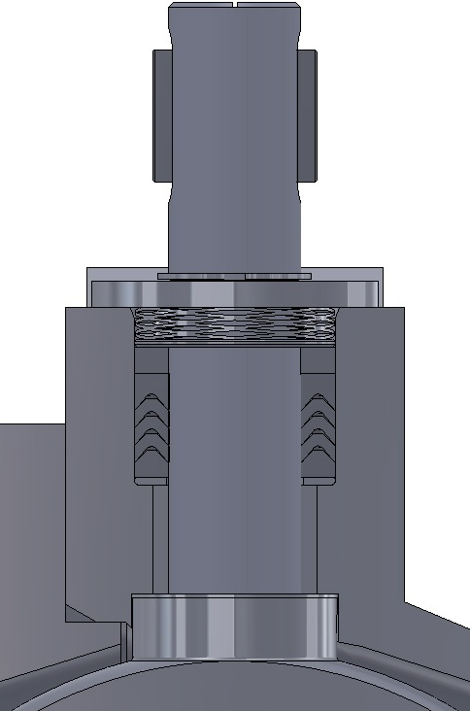
Fire safe stem seal design
Standard design
Fire safe design
R-PTFE V-rings
Graphite ring
R-PTFE V-rings
PTFE body seal
Graphite body seal

Slide 12
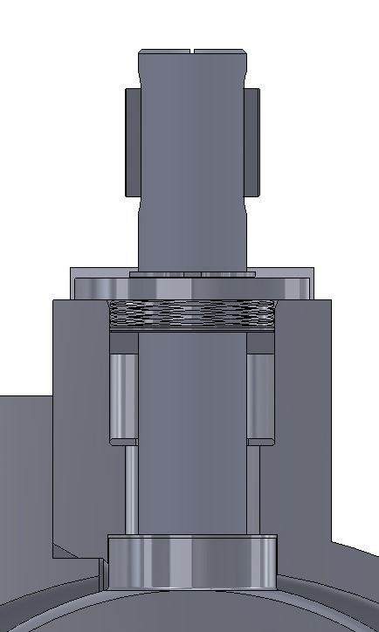
Fire safe design
Before burn
After burn
Graphite >
  Primary “After-burn” seal
R-PTFE V-rings >
  Primary “pre-burn”, multistage seal
  minimum risk for
  leakage
Metal-to-metal >
  Secondary “after-burn” seal
Unique fire safe stem seal design> Minimized risk for non-planned plant downtime and emissions to atmosphere during normal operation due to the spring loaded R-PTFE v-rings in combination with graphite

Slide 13
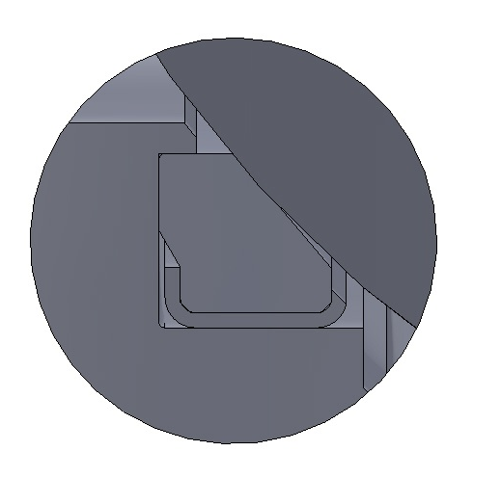
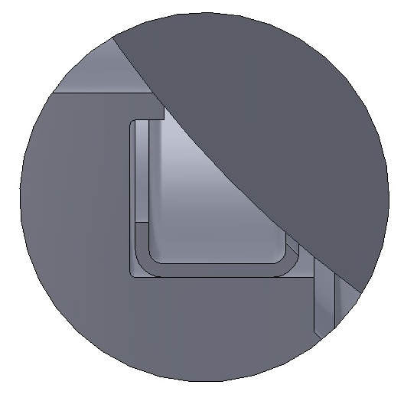
Fire safe design
Before burn
After burn
Ball seals against seat
Ball seals metal-to-metal against body lip
Notes:
.

Slide 14
Duball DL, materials
Body materials, standard:
CF8M (stainless steel), WCB (carbon steel)
Ball material/coatings standard:
CF8M, CF8M+hard chrome, CF8M+Alloy 6, CF8M+electroless nickel, solid Alloy 6
Optional materials (on request), examples:
CF8, CG8M, CF3M, CG3M, Duplex EN 1.4470, CW-12MW (Hastelloy), 904L, M35-1 (Monel), CK3MCuN (254SMO), Titanium B367 Grade C2

Slide 15
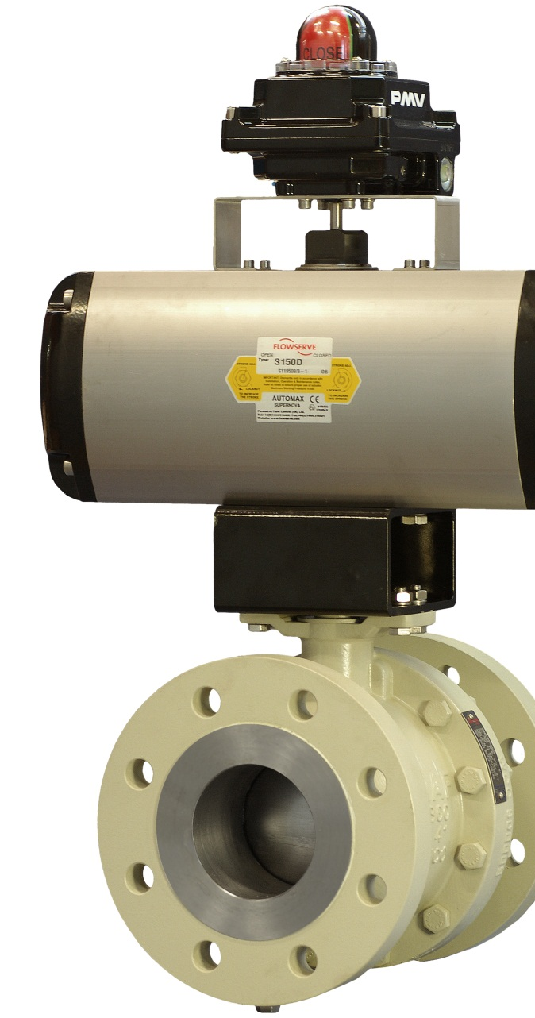
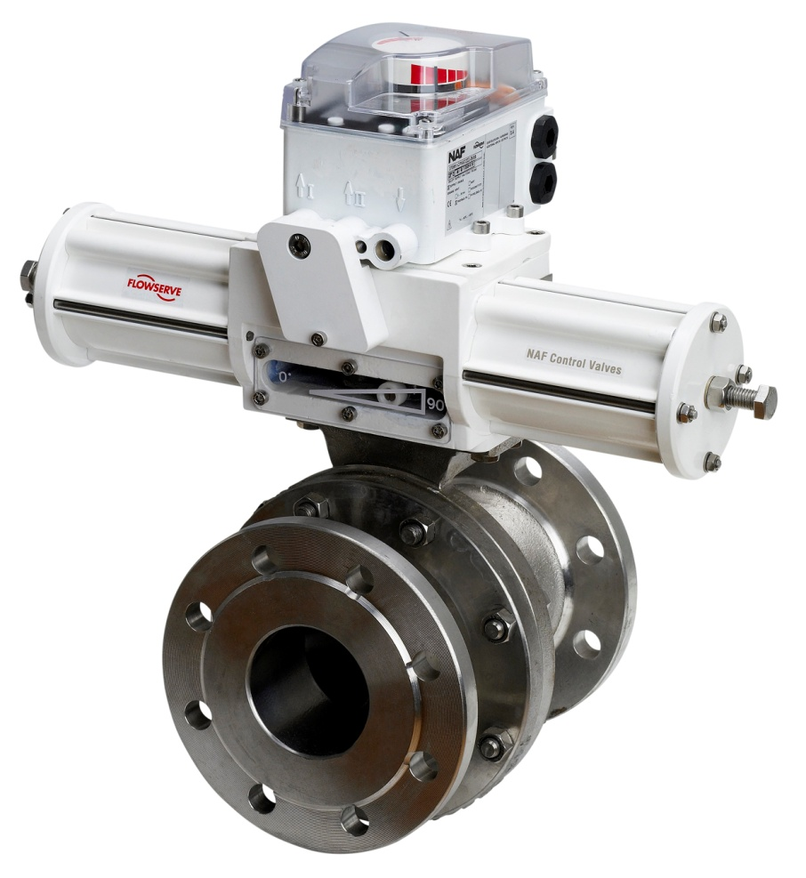
Duball DL, automation
Direct actuator mounting of the Turnex actuator which provides a high performance, vibration resistant, compact valve package
ISO 5211 mounting of the Automax Supernova actuator which provides a cost effectiv package for automated on-off

Slide 16
Duball DL, some typical applications
All ball valve applications on all type of digesters in a pulp plant
Pulp line applications in the fiberline in washing, screening and bleaching areas
White, black and green liqour applications in the chemical recovery area of a pulp plant
Water and steam applications
Air separation applications
Applications with fibers or slurries
PVC and other polymer applications
Mud applications in waste water plants
General applications where a high Cv is needed in combination with dual tightness

Slide 17
NAF Duball DL
Material: CF8M, WCB
(Duplex, Hastelloy etc.)
Sizes: DN25-DN400
ANSI 1” – 16”
Full bore
Pressure class: PN10-PN40
ANSI Class 150 & 300
Tightness class: PTFE-seats: EN 12266-1:2012, rate A ISO 5208, rate A)
Metal seats: EN 60534-4, Class V
ANSI FCI 70-2, Class V
Connection: Flanges
Temperature: -30 - 250°C
-22 - 482°F

Slide 18
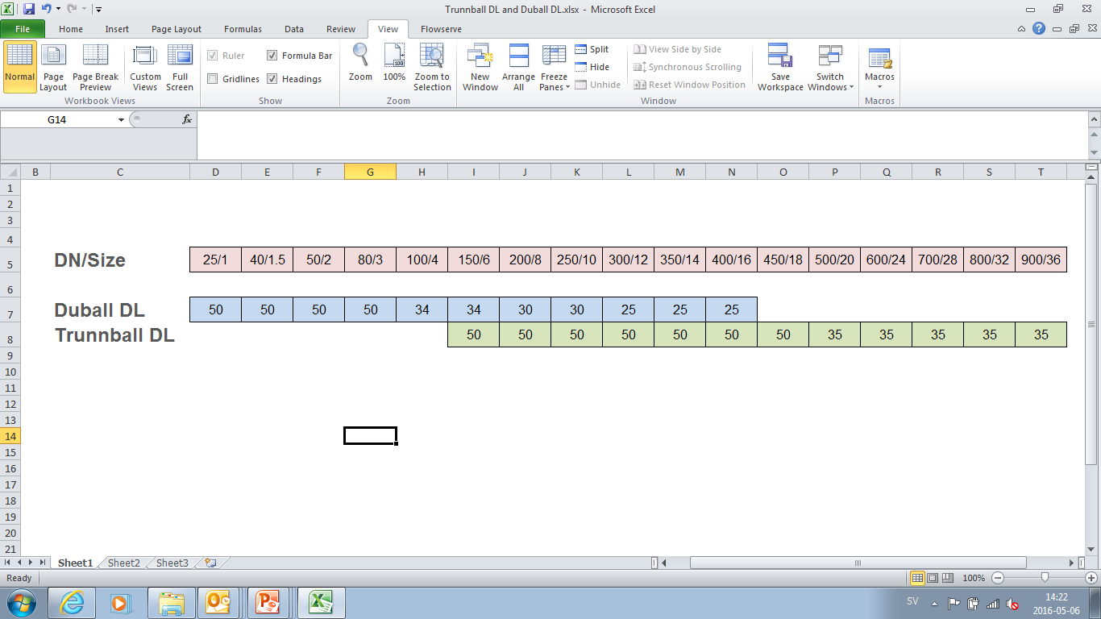
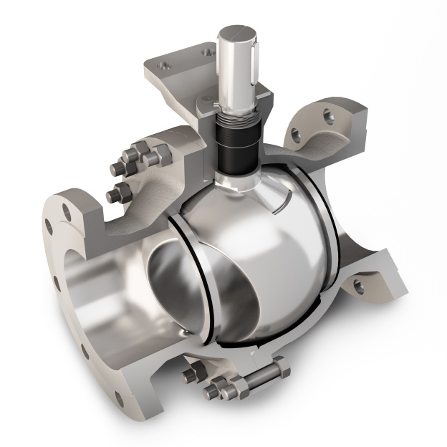
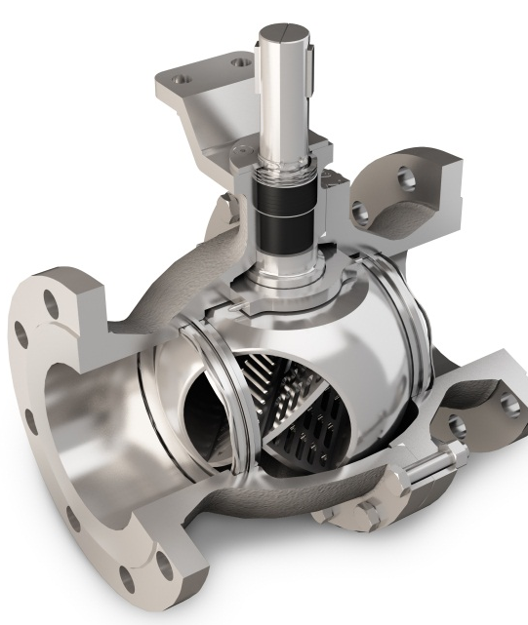
NAF Duball DL + NAF Trunnball DL
The complete range of NAF flanged full port ball valves
Maximum allowed dp
NAF Duball DL, floating ball
NAF Trunnball DL, trunnion mounted ball
Notes:
The following slides regarding the advantages of a V-port are mainly pointing against competitors (like Somas) who are not using a V-port and still claim their solution is a better control valve. In fact it shows that their valves have a quick openinng behaviour in the majority of installations. They are therefore best suited as on-off valves rather than control valves.
- The advantage with the V-port is also shown when it is used in controlling pulp as it prevents dewatering
- When comparing to linear control valves, the rangeability, related to the V-port, in combination with the high flow capacity, makes the Setball SF a financially good alternative for may hig flow, low pressure applications.

Slide 19
Summary of features and benefits of
NAF Duball DL
Based on one of the most proven metal seated ball valve designs in the world (>50 000 units sold) > Safe investment
State-of-the-art spring loaded stem seal packing that guarantees a long maintenance-free and safe operation in automated on-off and control service > Minimized risk for non-planned plant downtime and emissions to atmosphere
With the PTFE V-ring stem seal, the valve can take applications up to 250°C/482°F in it’s standard configuration > Minimized inventory need due to the temperature coverage
Unique fire safe stem seal design> Minimized risk for non-planned plant downtime and emissions to atmosphere during normal operation due to the spring loaded R-PTFE v-rings in combination with graphite
Direct actuator mounting capabilities of the Turnex actuator which provides a high performance, vibration resistant, compact valve package > Lower maintenance cost, better control performance

Slide 20
Summary of features and benefits of
NAF Duball DL
Sturdy, blowout-proof stem with a long foot providing a high torque transmission with a minimum mechanical backlash > Safe operation, better control performance
Unique Z-trim™ option that minimizes cavitation and noise and has an excellent control characteristic > Better working environment, lower maintenance cost for wear, better control performance
An extreme size range, DN25/1” up to DN400/16” > Cover the majority of floating ball valve applications in a plant
Easy-to-service arrangement, due to the offcenter joint face of the valve body, which allows for easy replacement of the ball and seals, without the need for removing the stem and actuator > Minimized time for maintenance and plant downtime
Metal seats with a rigid welded overlay of Alloy 6 or alternatively metal encapsulated, reinforced PTFE seats > Minimized risk for non-planned plant downtime due to seat damage
Wide range of optional versions > Flexible, covers virtually all needs

Slide 21
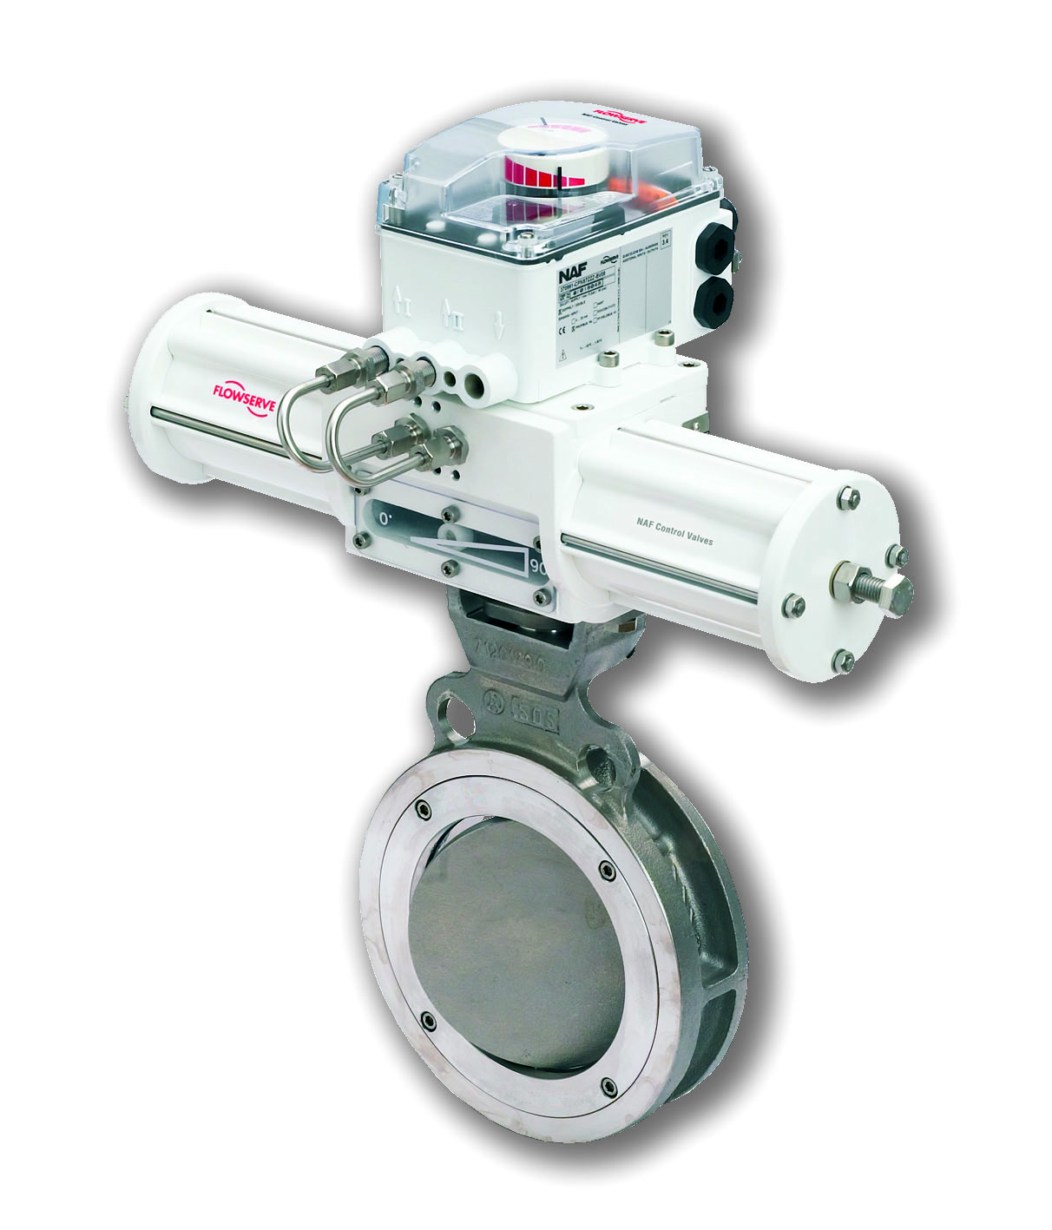
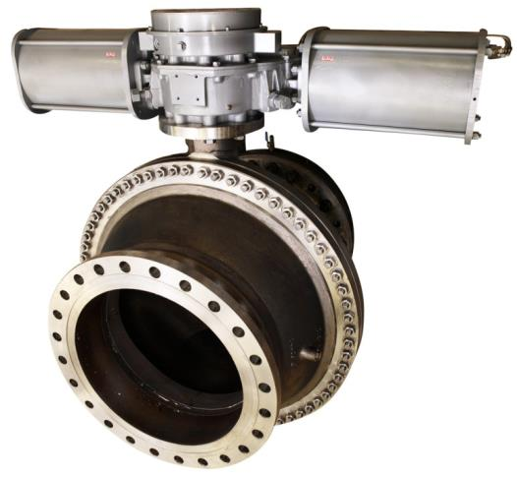
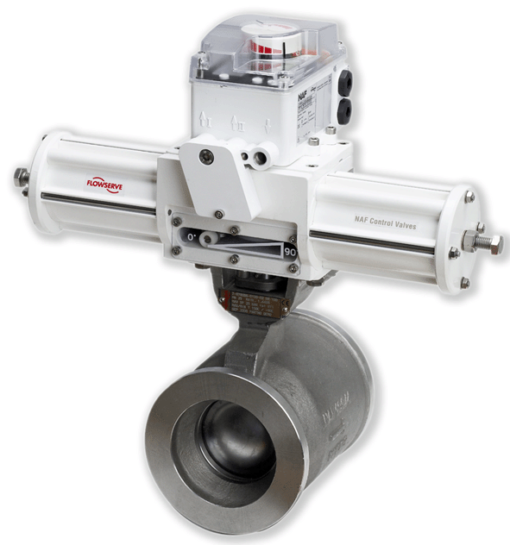
. . and our other rotary control valves . .
NAF Torex
High performance, triple offset butterfly valve
DN80/3”-DN700/28”, wafer&lug style
PN10-PN40/ANSI Class 150 and 300
NAF Trunnball DL
High performance, trunnion mounted ball valve
DN150/6”-DN900/36”
PN10-PN40/ANSI Class 150 and 300
NAF Setball
High performance, V-port, segmented ball valve
Wafer, Flanged, SF and MC-pulp versions
DN25/1”-DN500/20”
PN10-PN40/ANSI Class 150 and 300

Slide 22
Appendix 1: Duball v.s. Duball DL
 | Duball | Duball DL
Temperature (std version) | 200°C | 250°C
Maximum Differential Pressure | 25 bar | up to 50 bar
Flow Capacity Cv | 1x | up to 2x
Firesafe | No | Yes
Carbon Steel | No | Yes
High temp version | Yes | No

Slide 23
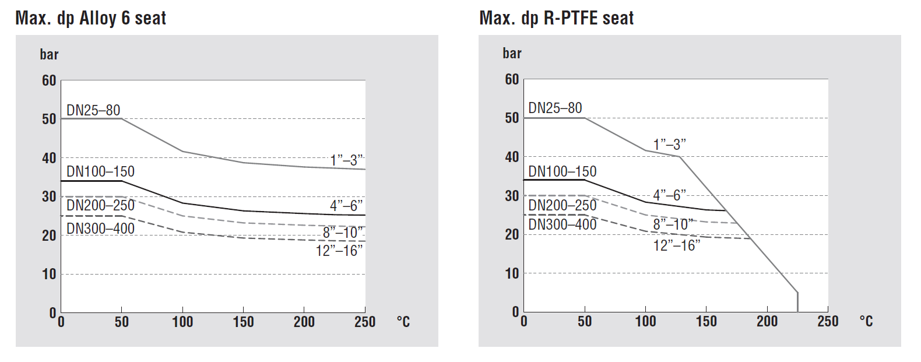
Appendix 1: Maximum allowed
differential pressure for Duball DL

Slide 24
Thank you for your attention

